Slide 1


Inland Marine Insurance

Slide 2
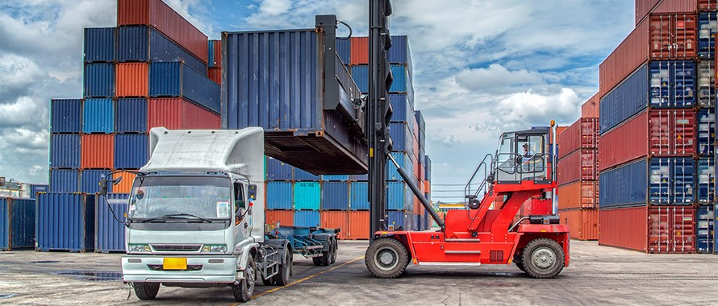
Objectives
Understand Inland Marine Insurance
Understand the role of inland marine insurance
Understand the distinction between filed and non-filed classes
Study property covered under filed classes
Study property covered under non-filed classes

Slide 3
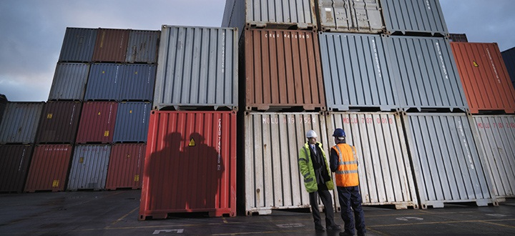
Inland Marine Insurance
This is the insurance that covers different classes of property that typically involve and element of transportation
It is divided into two categories:
Filed class of business: Rates must be filed with the state insurance department
Characterized by a large number of potential insured and reasonably homogenous loss exposures
e.g. musical instruments, photographic equipment etc.
Non-filed class of business: Neither the policy forms
nor the rates need to be filed with the state insurance
department
The non-filed classes vary by state
Characterized by small number of potential insured,
diverse loss exposures or both
e.g. contractor’s equipment, motor truck cargo liability
electronic data processing equipment etc.
Causes covered in named peril include – Flood, hurricane or tornado, fire and/or lightning, collision and/or overturning of a transporting conveyance, explosion and earthquake

Slide 4
Inland Marine Insurance contd…
Filed classes:
Commercial articles – Photographic equipment and musical instruments used commercially by photographers, motion picture providers, professional musicians and others
It is not intended for dealers in these property
Coverage can be provided on scheduled or blanket basis
Camera and musical instrument dealers – Coverage is intended for dealers in these property or property of others in their care, control or custody
Equipment dealers – Covers the stock of dealers that sell agricultural or construction equipment
Physician and surgeon’s equipment – Covers professional equipment, materials, supplies and books of physicians, surgeons and dentists
More coverage can be added by endorsement:
Office equipment while of premises (maximum up to 30 days)
Extra expenses following a covered loss
Valuable records

Slide 5
Inland Marine Insurance contd…
Theatrical property – Covers stage scenery, costumes and other personal property used in theatrical productions
Accounts receivable – Pays the amount of accounts receivable the insured is unable to collect, cost to reconstruct the records, interest on loans made necessary by inability to collect account receivables
Coverage may be written on a reporting or non-reporting basis
Films – Covers exposed motion picture film and magnetic tapes or videotapes, including related sound tracks or sound records. Pays for cost of reshooting the film if it is lost or damaged
Valuable papers and records – Covers architects blueprints and plans as well as the cost of research to reconstruct the records. Irreplaceable records are scheduled with an agreed value

Slide 6
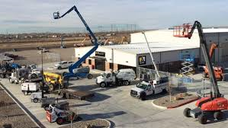
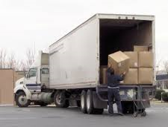
Inland Marine Insurance contd…
Non filed classes:
Contractors equipment – Covers cranes, earthmovers, tractors, stone crushers, bulldozers, portable offices.
Coverage can be provided on individual or blanket basis
Coverage is provided on open and named peril (fire, lightening, explosion windstorm etc.) basis
Frequently included rental reimbursement coverage
Builder’s risk – Covers structure under construction, temporary structure and building materials. Coverage is provided on open perils basis excluding floods, earthquake and theft
Transit – Covers owners of the property against damage to their property while transit by land air or water.
Trip transit and annual transit versions available.
High risk articles and contraband property are generally excluded
Annual transit policies are mostly issued on open peril basis and valued at amount of invoice

Slide 7
Inland Marine Insurance contd…
Motor truck cargo liability – Provides liability coverage for motor carrier for the property being transported with a terminal coverage generally limited to 72 hours. Valuable property generally excluded
Difference in conditions – Intended to fill gaps on an “all risks basis” in the commercial property coverage
Electronic data processing equipment – Covers computers, equipment, software and electronic data
Equipment can be valued at ACV/replacement/upgraded value
Data and media valued at the actual cost of reproduction or for an agreed value
Bailee's – Covers bailees for the property in their care or custody regardless of their liability. Generally issued for dry cleaners, laundries, tailors, repair shops etc.

Slide 8
Inland Marine Insurance contd…
Coverage for all articles are provided on an open-peril basis – direct physical loss is covered by any cause which is not specifically excluded
Policy can be packaged in CPP (Package modification factors apply) or issued as a mono-line policy
Property is generally valued on ACV basis. Other valuation methods also application subject to the agreement of insured
ISO and AAIS file forms and rates for the classes of business with the state departments
Insurers can customize appropriate policy provisions if the rates are not files with the state departments
Judgment rating is used to determine the rate one-of-a-kind risks for which rates are not available in CLM
Governmental action, nuclear hazard, military actions are excluded

Slide 9
Thank You

